Slide 1

Car Rental
Analysis
DS340
Completed By: Irfan Rathore

Slide 2
AGENDA
01
Dataset overview and exploration.
02
Data cleaning and preprocessing.
03
Exploratory Data Analysis (EDA).
05
Key findings and recommendations.
OUR PROCESS

Slide 3
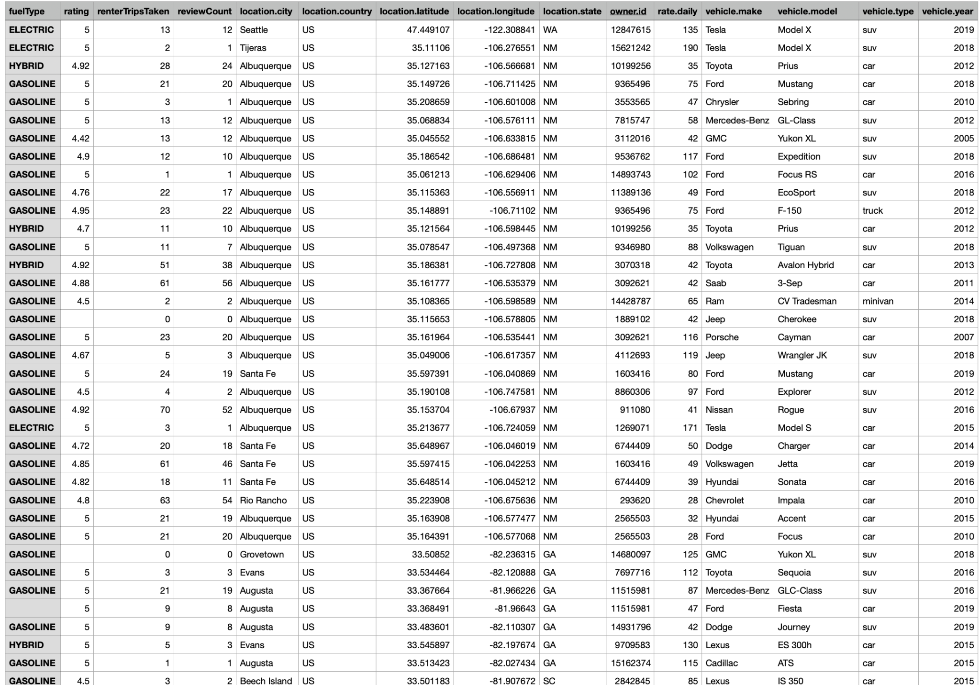
The Dataset
The dataset contains details of car rentals, including:
Car model, make, and year.
Rental price, fuel type, and city.
Additional metrics like customer ratings and reviews.
Database Link

Slide 4
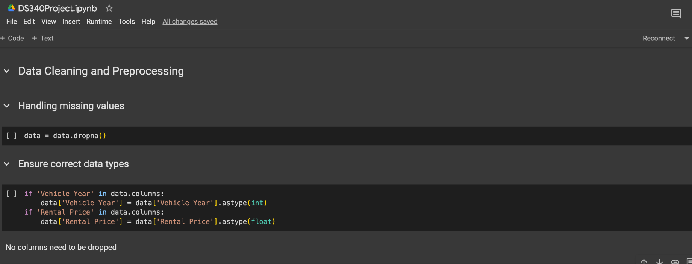
Data Cleaning and Preprocessing
Steps performed:
Handled missing values by dropping incomplete rows.
Ensured proper data types for numerical and categorical columns.
Removed irrelevant columns (e.g., geolocation data).

Slide 5
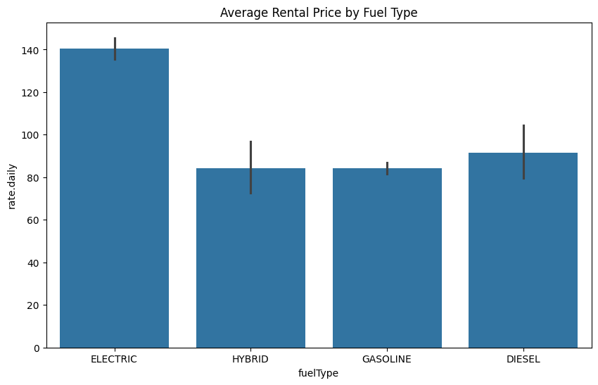
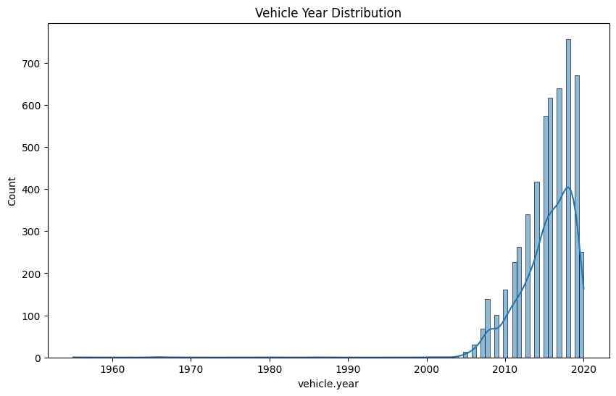
Exploratory Data Analysis (EDA)
Key insights discovered:
Popular Models: Tesla and Toyota Corolla are rented most frequently.
Price Trends: Electric vehicles have higher average rental prices than gasoline or hybrid cars.
Regional Demand: Electric cars are most in demand in metropolitan cities.
Visualizations:
Bar chart of average rental prices by fuel type.
Histogram of vehicle years in the dataset.

Slide 6
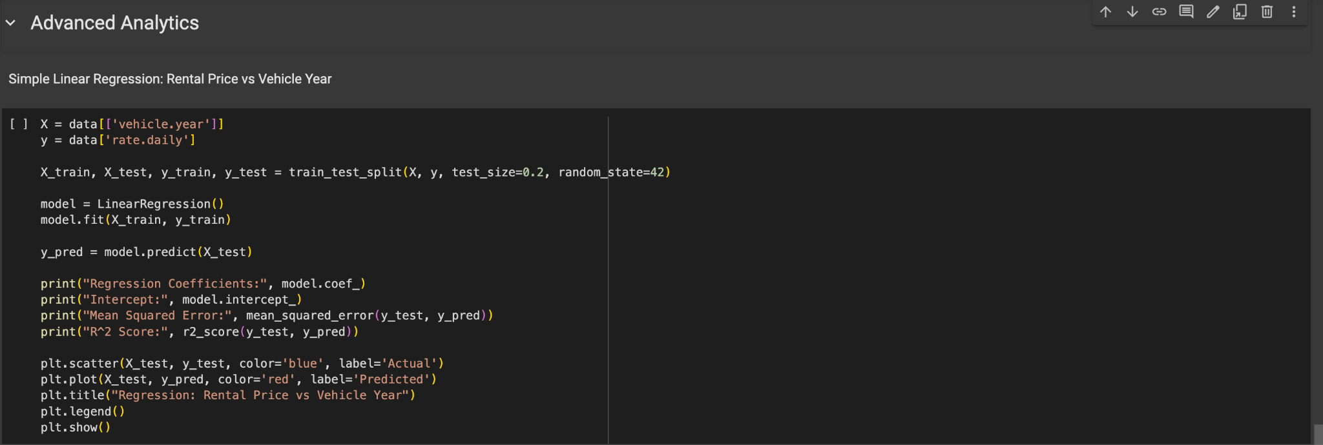
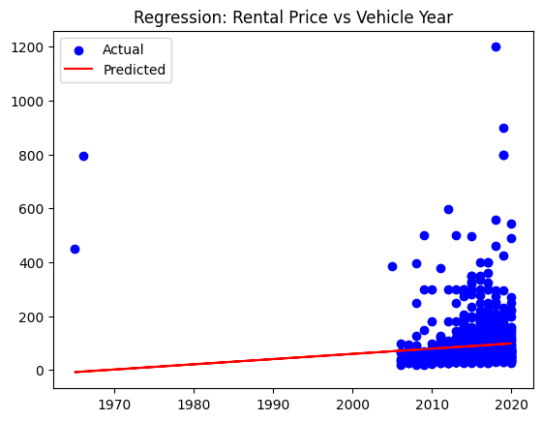
Regression Analysis
Examine the relationship between rental price and vehicle year.
Model: Simple Linear Regression
Formula: Rental Price = β0 + β1 * Vehicle Year + ε
Results:
Regression Coefficient: +$X per year increase.
Model Accuracy (R²): X%.

Slide 7
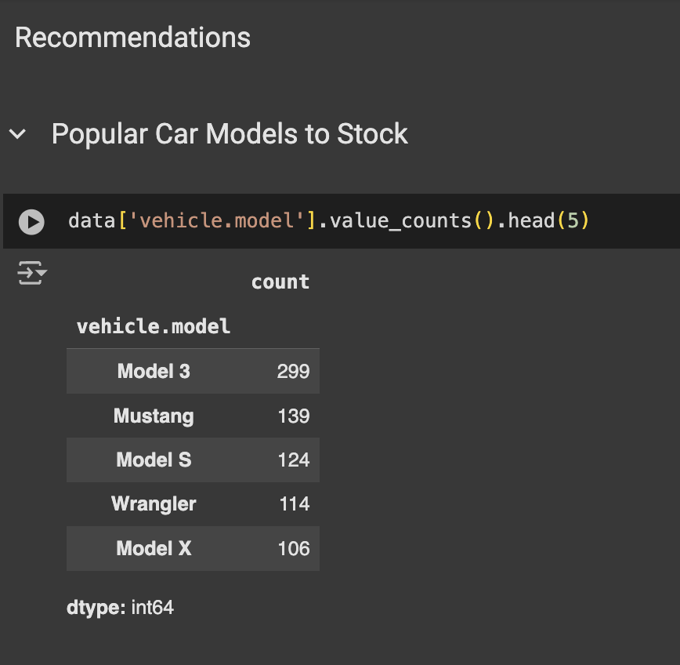
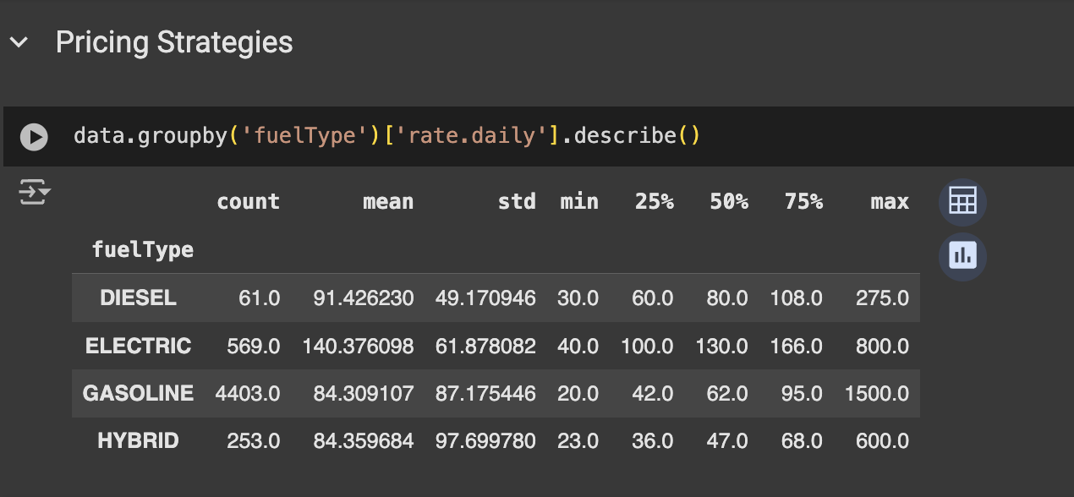
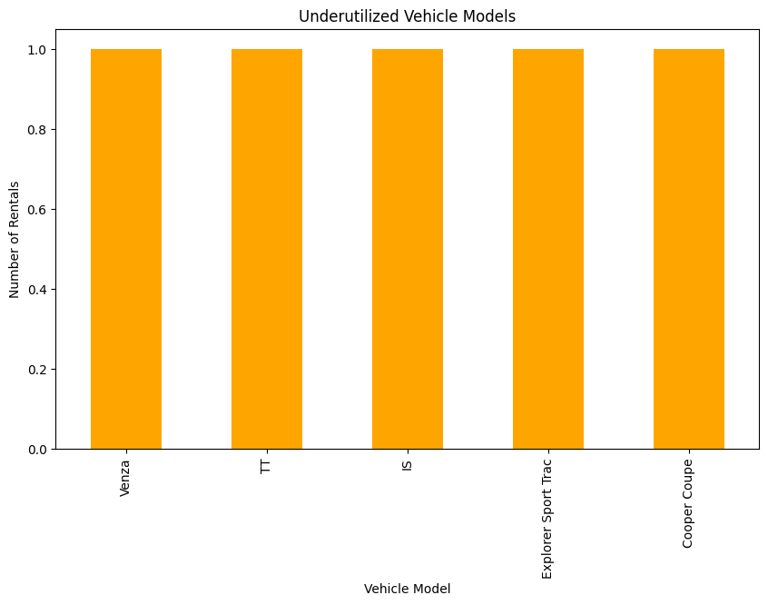
Recommendations
Findings
Stock more electric and hybrid cars in high-demand regions.
Adjust pricing strategies for older vehicle models.
Target marketing campaigns to promote underutilized vehicles.
Focus on metropolitan areas for electric car promotions.
Notes:
Purpose:
"This 2D PCA plot is a dimensionality reduction visualization, showing how players are grouped into clusters based on their performance metrics. It simplifies the high-dimensional data into two principal components while preserving the variance as much as possible."
What Each Point Represents:
What is represented?
Each dot represents an individual NBA player. Players are grouped based on their similarity in metrics such as Points, Assists, Rebounds, and Defensive Contributions.
"The clear separation between clusters reflects the distinct roles of players based on performance."
"Some overlap (e.g., between Cluster 1 and Cluster 2) indicates shared characteristics, such as balanced players who also contribute defensively."

Slide 8
Conclusion
Project Summary:This project analyzed a comprehensive car rental dataset to uncover trends and actionable insights.
We explored rental behaviors across vehicle models, fuel types, and geographic locations, providing a detailed understanding of the market.
Key Achievements:
Data-Driven Insights: Identified the most popular car models, average rental prices by fuel type, and city-specific preferences.
Advanced Analysis: Used regression modeling to understand the impact of vehicle year on rental pricing trends.
Actionable Recommendations: Proposed strategies for stock optimization, pricing adjustments, and targeted marketing.
Real-World Applications:
Operational Efficiency: Insights can help rental companies optimize their fleet composition by stocking high-demand vehicles and adjusting pricing strategies based on fuel type and vehicle year.
Customer Targeting: Marketing campaigns can be tailored for specific cities or customer preferences, such as promoting electric vehicles in urban areas.
Market Positioning: These findings enable companies to align their offerings with emerging trends like eco-friendly cars and urban demand for newer vehicles.
Broader Impact:
This project demonstrates the critical role of data analytics in decision-making within the car rental industry.
By leveraging data, companies can improve profitability, enhance customer satisfaction, and stay ahead of market trends.

Slide 9

THANK YOU

